Slide 1



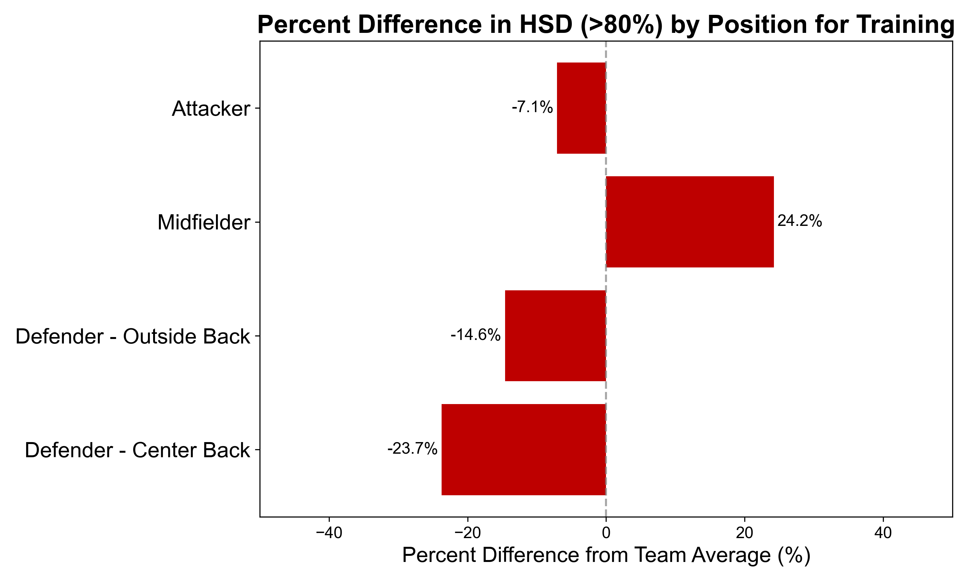
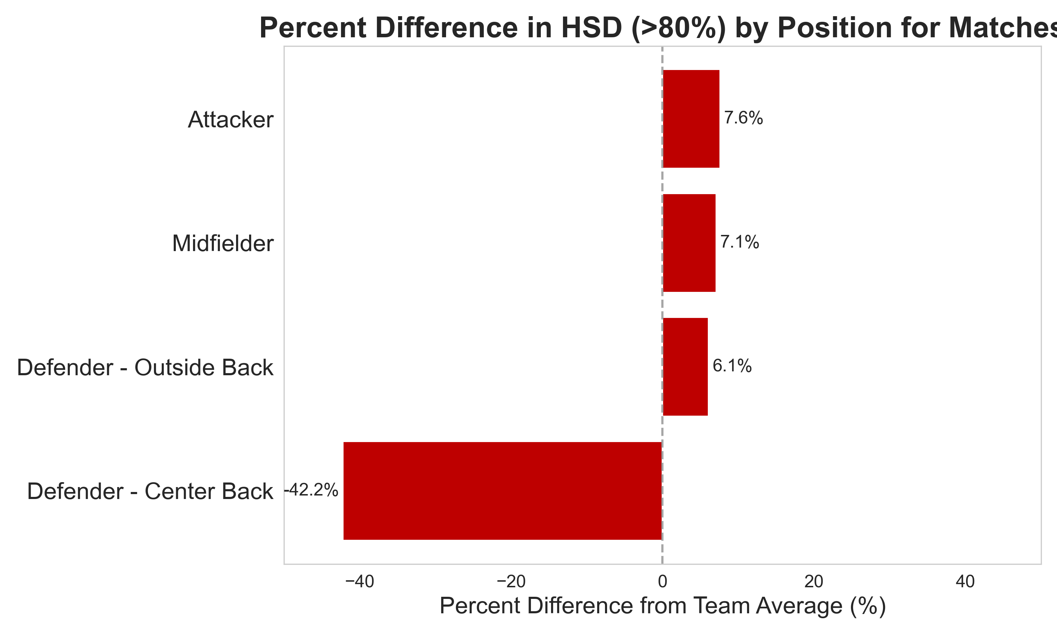
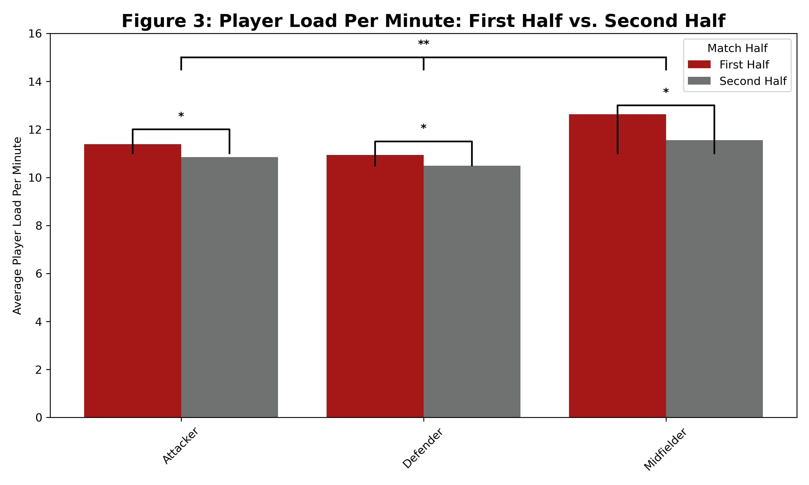
Characterizing Positional Performance Demands for Utah Women's Soccer Greta Czachor, Cooper Kerr, Sophia Terrill
Introduction
Results
Conclusions
Soccer positions can broadly be broken into 4 distinct positions (goal keepers, defenders, midfielders, attackers) each with a unique role that calls for different play strategies during matches
Defenders can further be separated into the specific positions of outside back and center back for secondary analysis due to differences in their specific roles
Wearable technology allows for tracking of player data making it possible to understand the physical demands being placed on players, at Utah we use Catapult devices worn between player's scapulae during all matches and trainings
Key metrics:
Duration (volume metric, time players are in match)
Total Player Load (volume metric, indicates overall work done in a session)
Player Load/min (PL/min - density metric that shows work rate)
Total Distance (volume metric, distance covered)
Total High-Speed Distance (HSD - intensity metric, distance covered at over 80% of a player's personal career maximum velocity)
High and Medium Inertial Movement Analysis Change of Direction/Acceleration/Deceleration (H&M IMA COD/Accel/Decel – intensity/volume metrics tracking directional movements and classifying them based on direction and intensity of movement)
Dive Count and Dive Load (GK specific volume metric that quantifies the number of dives during a session and the overall work done during these dives)
Table 1.1 Average Performance Metric Values by Position in Matches
Table 1.2 Average Performance Metric Values for Goalkeepers in Matches
There is a statistically significant difference (p≤0.05) between some positions for all key metrics (Total Player Load, PL/min, Total Duration, Total Distance, Total High-Speed Distance, H&M IMA COD/Accel/Decel) indicating that the demands of individual positions vary
Players should receive position specific preparations to address the statistically significant differences in position demands
There is statistically significant differences in the relationship between individual position's key metric averages compared to team averages in matches vs training data indicating a misalignment in match and training exposures
Within defenders, center backs and outside backs have different trends indicating a potential need to treat these positions as distinct
There is a statistically significant difference between first half average PL/min and second half average PL/min, indicating players on average have a significantly lower density during the second half, likely due to fatigue
 | Defender | Midfielder | Attacker
Duration (min) | 70.41 | 66.38 | 54.02
Total Player Load (unitless) | 748 | 790 | 593
Player Load/min | 9.8 | 11.6 | 10.1
Total Distance (m) | 7262 | 7331 | 5780
Total High-Speed Distance (m) | 42 | 54 | 60
H&M IMA COD R/L (count/min) | 0.19 / 0.26 | 0.21 / 0.29 | 0.23 / 0.32
H&M IMA Accel (count/min) | 0.33 | 0.26 | 0.26
H&M IMA Decel (count/min) | 0.42 | 0.44 | 0.34
Goalkeepers
Duration (min) | 85.03
Player Load (unitless) | 354
Player Load/min | 3.71
Total Distance (m) | 5225
Total High-Speed Distance (m) | 3
Dive Count | 5
Dive Load (unitless) | 44.5
*goalkeeper metrics are significantly different from metrics in all other positions
Key:
= Significantly different from defenders
= Significantly different from attackers
= Significantly different from midfielders
Limitations
Small sample size required grouping of specialized positions to broader positions for main analysis. Defender's averages specifically were watered down to an average that doesn't represent either specific position
Small sample size reduced statistical power and generalizability
Reduced amount of goalkeeper data (one less season of match data for goalkeepers because units weren't worn, 12 instances of partially missing data in goalkeeper data used)
9 in-game field player instances of invalid data due to Catapult malfunctions
Figure 1.1 Percent Difference in HSD (>80%) by Position in Training
Figure 1.2 Percent Difference in HSD (>80%) by Position in Matches
Question
Primary question: Is there a significant difference between each position's average performance metrics in matches?
Secondary question: Are the exposures that players need to be prepared for in matches occurring in trainings?
Why: Significant differences in match demands would indicate a need for different positional preparations in training
Next Steps
Figure 1.1 This figure represents the percent difference for each positional group's High-Speed Distance from the total team average of High-Speed Distance in training
Figure 1.2 This figure represents the percent difference for each positional group's High-Speed Distance from the total team average of high-speed distance in matches
Continue to generate more data!
Continue to explore high intensity exposure trends in matches compared to training, particularly for goal keepers
Characterize match performances to be "good" vs "bad" so that we are comparing trainings to average match metrics in "good performances" (i.e. a good defensive performance could be indicated by low shots on own goal)
Further explore the observed differences in outside back vs center back data and whether outside backs are more similar to a different position, additionally explore other specific positions like winger and center midfielder, among others
Further explore trends in the first half versus second half data in more variables to get more context for the observed PL/min reductions
Methods
Data collection with Catapult units during all field training and matches from Fall 2022 - Present
Generation of summary statistics for each position and play type to understand averages and distribution of data
Use of independent t-tests and significance tests for Total Duration, Player Load, PL/min, Total Distance, and Total High-Speed Distance
Use of Mann Whitney U test and significance tests for IMA metrics due to the non-normal distribution and uneven sample sizes
Statistical significance determined when p-values were ≤ 0.05
Figure 2 Player Load Per Minute: First Half vs Second Half
Figure 2 This figure represents the differences in PL/min observed when comparing first half vs second half averages within and between positions. These averages were calculated using only data from players who played +/- 10 minutes of their position's average duration due to the durations varying widely between positions and each position having a standard deviation of about 10 minutes in the first and second half.
*= significant difference between first half and second half
**=significant difference between positions for both first half and second half averages

